Slide 1




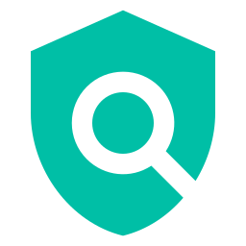

Kong APIM
Policy-Based API
Access Control
Envoy Gateway
Keycloak
Proof of Concept
APIM (Kong) + Envoy Gateway + Keycloak + OPA
with End-to-End Distributed Tracing
OPA
OpenTelemetry

Slide 2

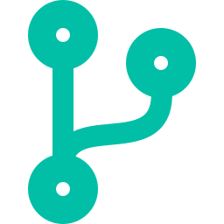

The Problem with Traditional Authorization
Why service-embedded access control creates operational risk
Duplicated Logic
Difficult Changes
Delayed Revocation
Authorization rules copied across every microservice, leading to inconsistencies and drift
Policy updates require code changes and redeployment of every affected service
Access changes can't take effect immediately — they wait for the next deployment cycle
This PoC demonstrates how policy-based authorization eliminates all three issues.

Slide 3

Core Design Principle
Authorization is fully externalized from application services.
REST API = Authorization-Agnostic
One Policy Decision Point
The API contains zero authorization logic. It serves business data only. All access decisions are evaluated dynamically by OPA.
OPA serves as the centralized PDP, evaluating RBAC, ABAC, and ReBAC rules from the same request context — without code changes.
New authorization models are added by extending OPA policies, not by changing service code.

Slide 4
Architectural Layers
Separation of concerns across six distinct layers
APIM
▶
Ingress
▶
Service
▶
AuthZ
▶
Identity
Kong
Envoy
FastAPI
OPA
Keycloak
Observability Layer — OpenTelemetry + Jaeger
APIM:
API governance, routing, rate limiting
Ingress:
JWT validation, external authorization
Service:
Business logic, zero auth rules
AuthZ:
RBAC + ABAC + ReBAC policy engine
Identity:
JWT token issuance via OIDC
Observability:
End-to-end distributed tracing

Slide 5
Runtime Request Flow
Every API request traverses the full policy-enforcement pipeline
External
Client
Kong
APIM
Envoy
Gateway
FastAPI
Service
1. Keycloak issues JWT access tokens
▶
▶
▶
2. Kong represents the APIM governance layer
3. Envoy validates JWTs via external authZ API
OPA
Authorization
4. REST API contains zero authorization rules
5. Denied requests never reach business logic
OpenTelemetry → Jaeger

Slide 6


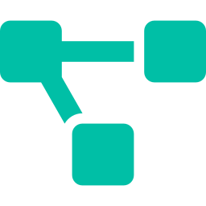
Authorization Models
One policy engine, three authorization paradigms
RBAC
ABAC
ReBAC
Role-Based Access Control
Attribute-Based Access Control
Relationship-Based Access Control
Admin accesses all customers
User reads only assigned customer
Auditor has audit-scoped access
Same region + allowed segment = access
Cross-region requests denied
High-risk requests blocked
RM assigned to customer = access
Auditor + audit purpose = access
Wrong purpose = denied

Slide 7
Test Scenarios & Results
Model | Scenario | Result
RBAC | Admin accesses all customers | ✓ 200
Scope | User accesses own customer | ✓ 200
Scope | User accesses another customer | ✗ 403
ABAC | RM same region + allowed segment | ✓ 200
ABAC | RM different region | ✗ 403
ABAC | High-risk request | ✗ 403
ReBAC | Auditor assigned + audit purpose | ✓ 200
ReBAC | Auditor assigned + non-audit purpose | ✗ 403
RBAC | User accessing /admin/customers | ✗ 403
RBAC | Admin accessing /admin/customers | ✓ 200
— | Request with no token | ✗ 401
13 scenarios tested · 13 traces verified in Jaeger · All scenarios passed

Slide 8
Policy Modularity
Centralized enforcement, decentralized ownership
common.rego
health.rego
customers.rego
JWT extraction, roles, shared helpers
Health endpoint access rules
Customer account access policies
abac.rego
rebac.rego
admin.rego
Attribute-based access policies
Relationship-based access policies
Administrative access policies
customers.json — Customer resource attributes (ABAC)
relationships.json — User-resource relationships (ReBAC)

Slide 9
End-to-End Distributed Tracing
Every request is traced across all layers via OpenTelemetry and Jaeger
Client
▶
APIM
▶
Gateway
▶
Service
▶
OPA
▶
Response
Trace Attributes Captured
Jaeger Filter Tags
http.method, http.route, http.status_code
enduser.id, user.role, customer.id
authorization.model (RBAC/ABAC/ReBAC)
opa.decision, opa.policy
authorization.result (allow/deny)
Tag Filter | Meaning
model=RBAC | Role-based scenarios
model=Customer Scope | Own/cross-customer
model=ABAC | Attribute-based
model=ReBAC | Relationship-based

Slide 10
Production Path: Azure APIM
Kong simulates the APIM layer — production maps directly to Azure
Layer | PoC Component | Production Equivalent
APIM Governance | Kong Gateway | Azure APIM
Cluster Ingress | Envoy | Envoy / AKS Ingress
Authentication | Keycloak | Entra ID / Keycloak
Authorization | OPA | OPA
Observability | OpenTelemetry + Jaeger | Azure Monitor / Grafana
Seamless Migration Path
Azure APIM replaces Kong while keeping the same service model
No secondary token issued — original identity flows through the entire chain
OPA policies remain unchanged during migration

Slide 11

What This PoC Proves
Externalized AuthZ
No Redeployment
Policy-based authorization replaces hardcoded access control
Authorization decisions change without redeploying services
Immediate Revocation
Multi-Model Coexistence
Access revocation takes effect through policy updates alone
RBAC, ABAC, and ReBAC run from the same policy engine
Full Observability
Modular Ownership
Every request traced across all layers in Jaeger
Domain-scoped policies with centralized enforcement
Authorization logic can be fully externalized from application services and enforced through a centralized policy engine.

